Slide 1
Verilog for Mixed-Signal
Greg Warwar
10/7/2025
Rev. 0.1

Slide 2
Verilog – The Basics
Verilog is a “Hardware Description Language”
It looks like C or Pascal --- It’s NOT
It lets you code like C or Pascal --- DON’T
Always keep in mind the transistor level gates that will the Verilog code description
Always be aware of which signals are state-variables (“regs”) and which are logically derived variables (“wires”)
A normal signal has 4 possible values : 0, 1, x, z
When a signal changes state, that is an “event” with an associated “event-time”
A Verilog simulation puts events into an event queue, which is always sorted with time.
Multiple events with the same event-time are processed independently and in parallel
You can override this with a “blocking” assignment (a = b) rather than (a <= b)
Never do this in code that will be synthesized! It’s ok in testbench code for simulation

Slide 3
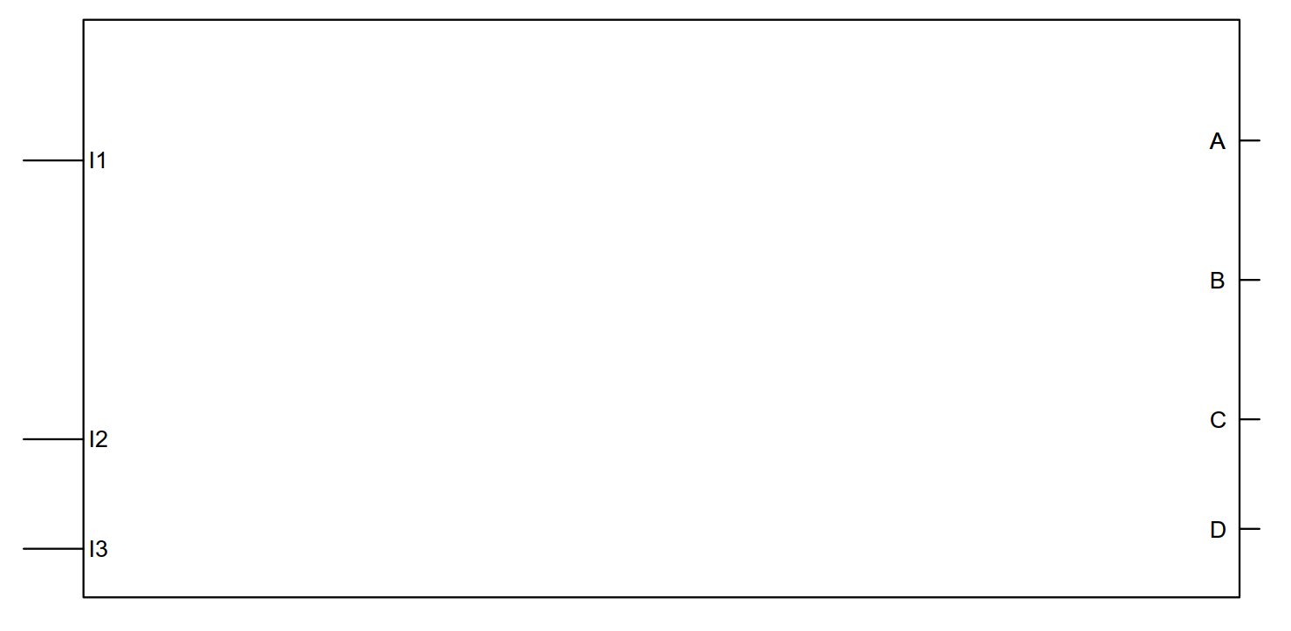
Optimized RTL Strategy
RTL BLOCK
CLK

Slide 4
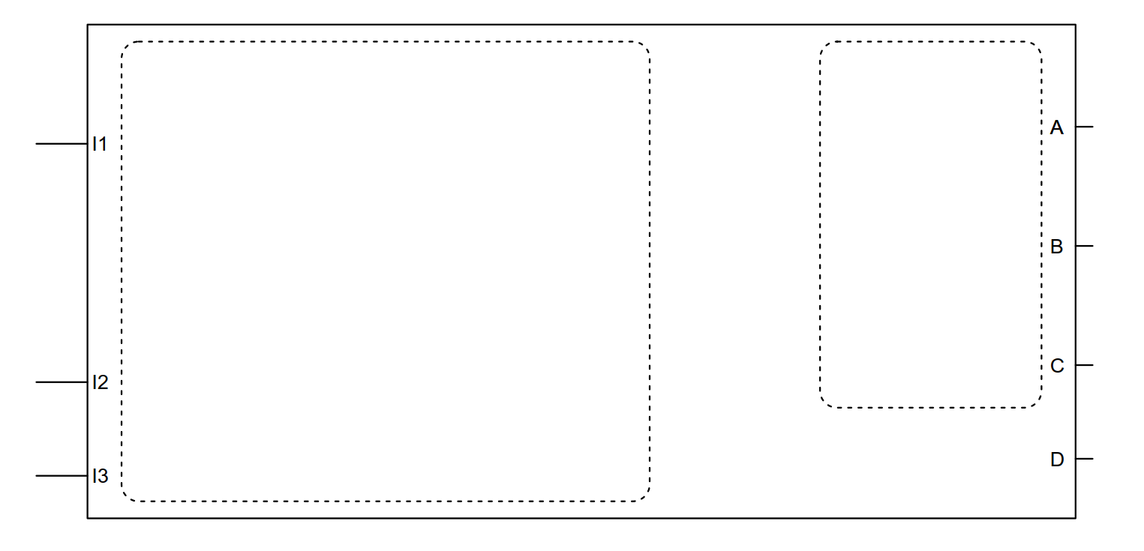
Optimized RTL Strategy - Partition
Memoryless
Logic
Regs
CLK

Slide 5
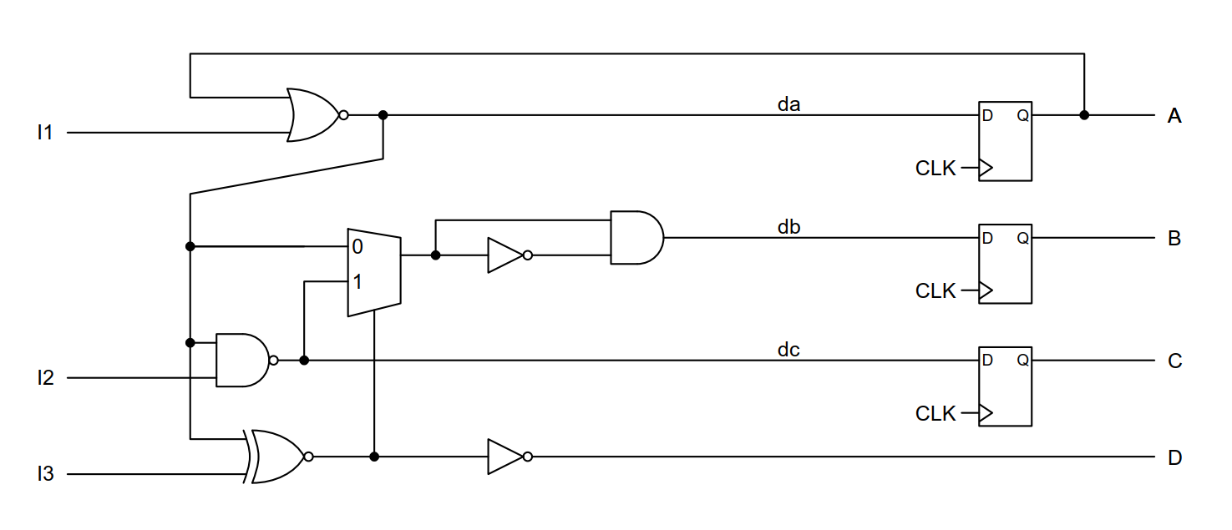
Optimized RTL Strategy - Partition
CLK
RTL BLOCK
CLK

Slide 6
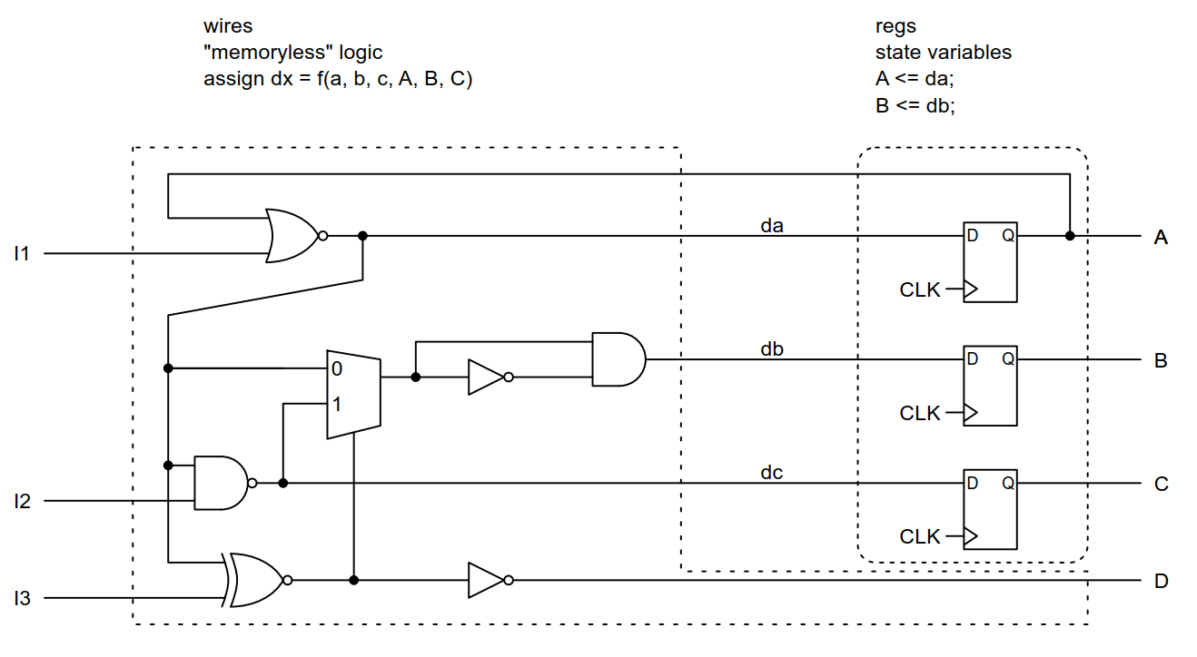
Optimized RTL Strategy - Partition
CLK

