Slide 1
PRBS Patterns
Theory, Generation, Checking, Uses, Pitfalls, and Practical Implementation
Greg Warwar
November 12, 2024

Slide 2
Agenda
The building blocks
How do they work?
Amazing Properties
Working with them efficiently – Verilog / Python
Related Uses – Dither / Scrambling
8B/10B Encoder-Decoder Example
References

Slide 3
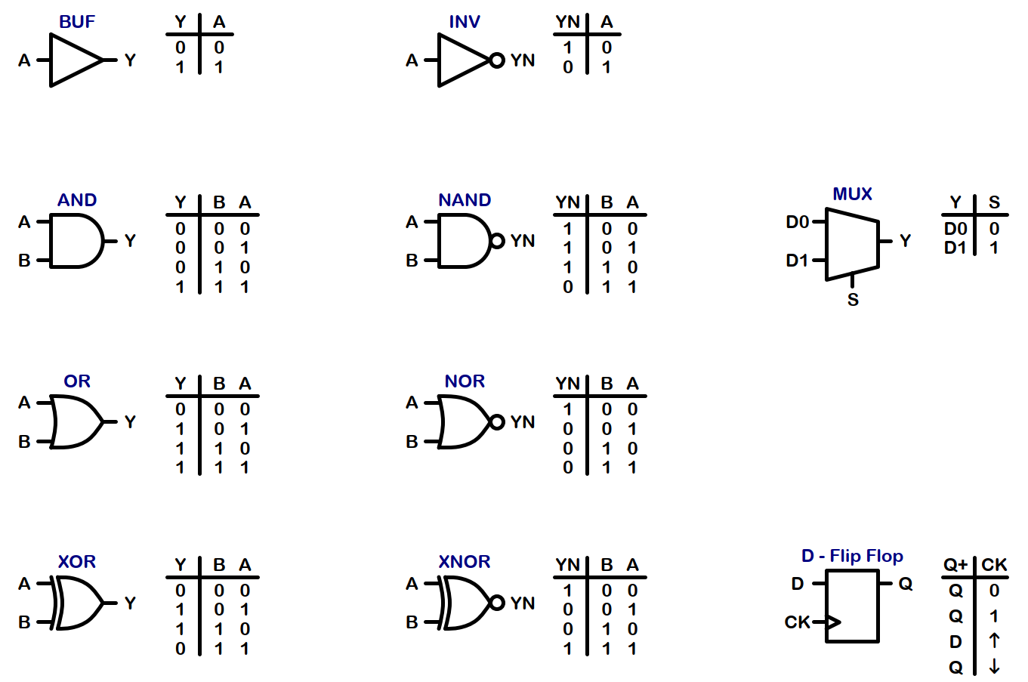
Logic Gates – The Building Blocks

Slide 4
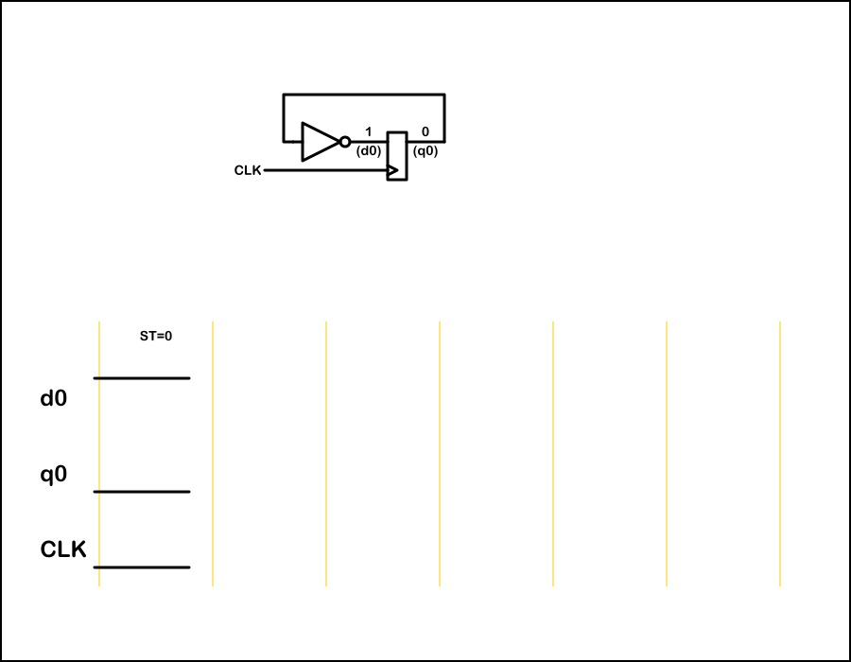
Simple State Machine – 1 Flip Flop

Slide 5

Simple State Machine – 1 Flip Flop (run)

Slide 6
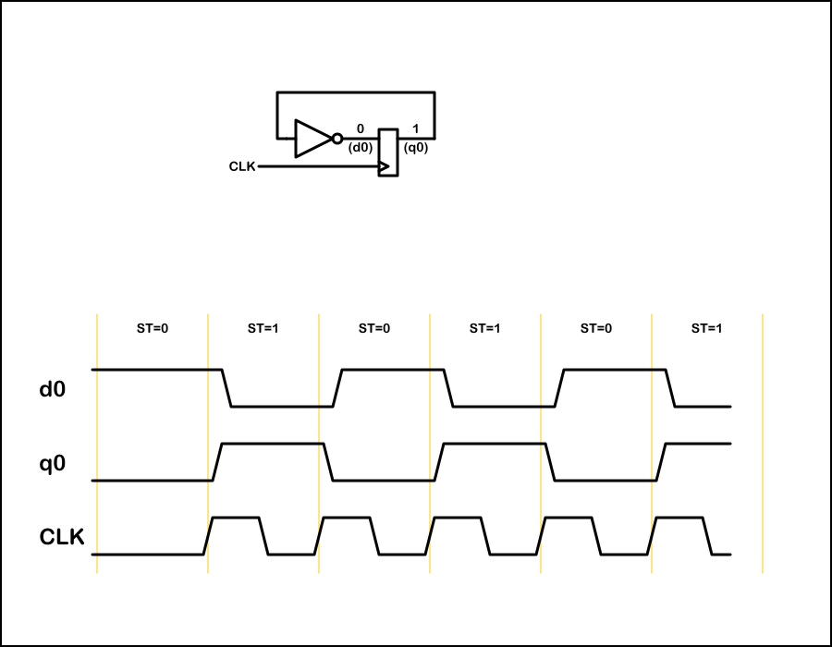
Simple State Machine – 1 Flip Flop (end)

Slide 7
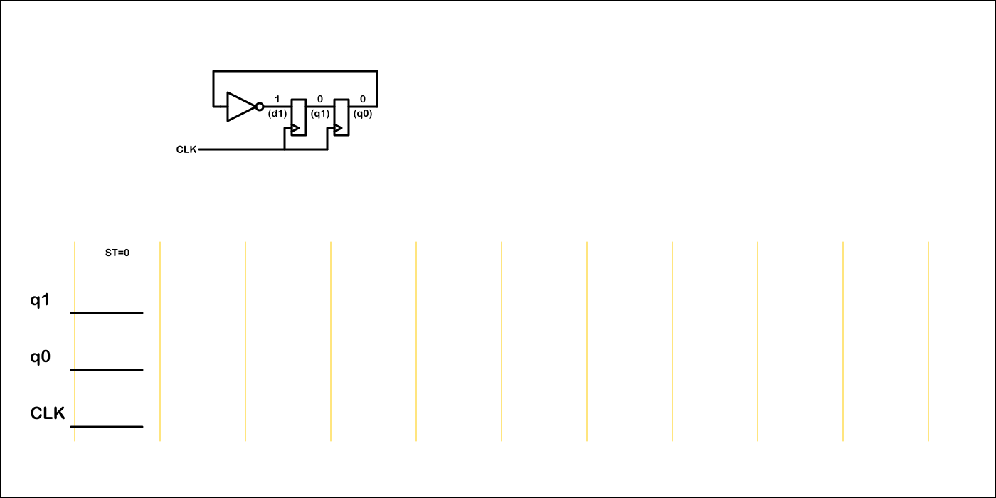
Simple State Machine – 2 Flip Flops

Slide 8

Simple State Machine – 2 Flip Flops (run)

Slide 9
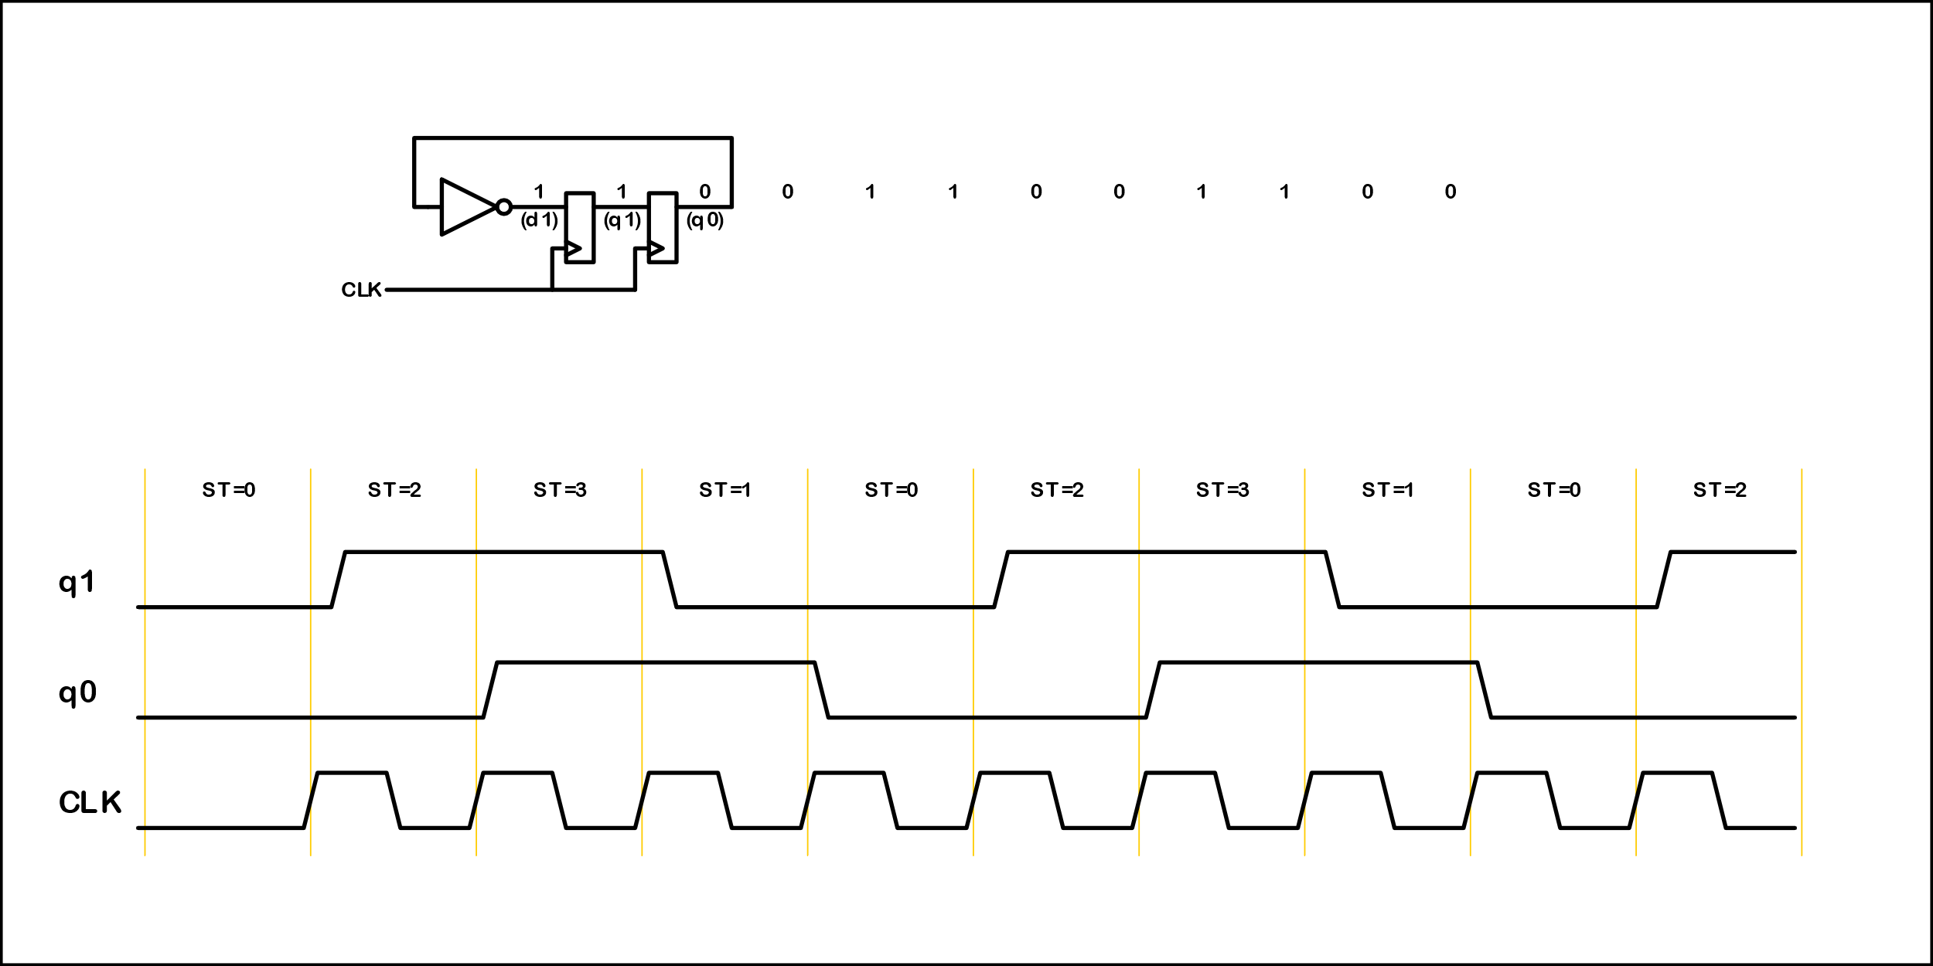
Simple State Machine – 2 Flip Flops (end)

Slide 10
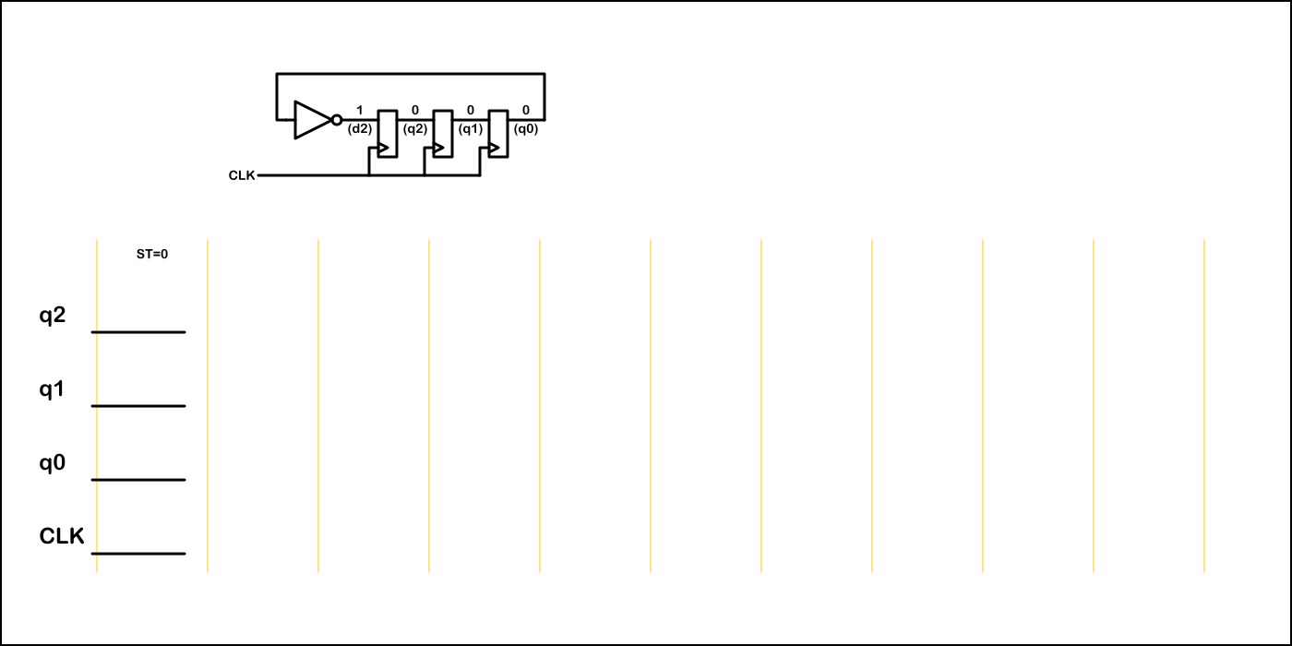
Simple State Machine – 3 Flip Flops

Slide 11

Simple State Machine – 3 Flip Flops (run)

Slide 12
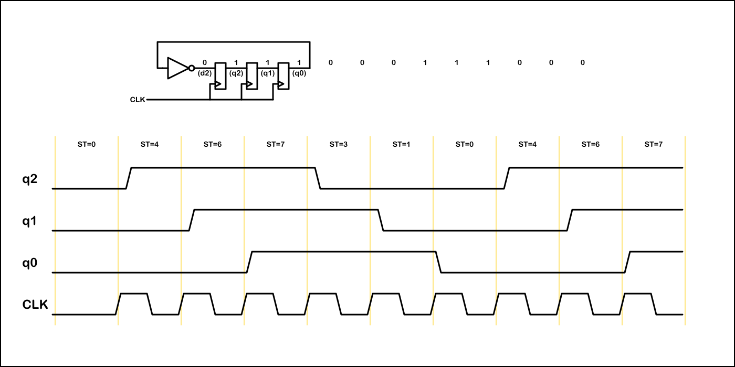
Simple State Machine – 3 Flip Flops (end)

Slide 13
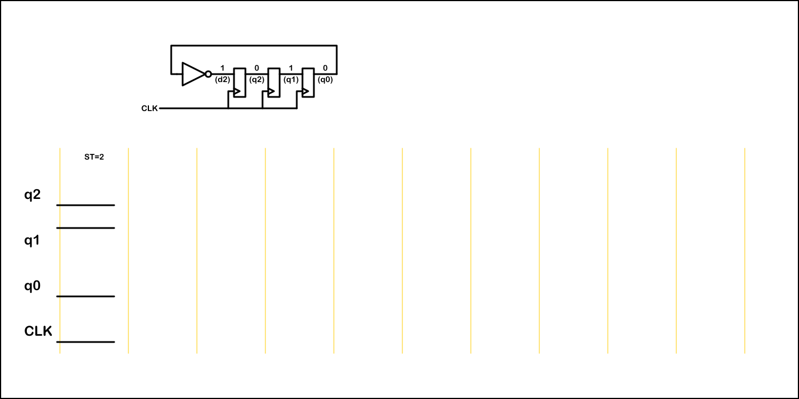
Simple State Machine – 3 Flip Flops (0 1 0)

Slide 14

Simple State Machine – 3 Flip Flops (0 1 0) run

Slide 15
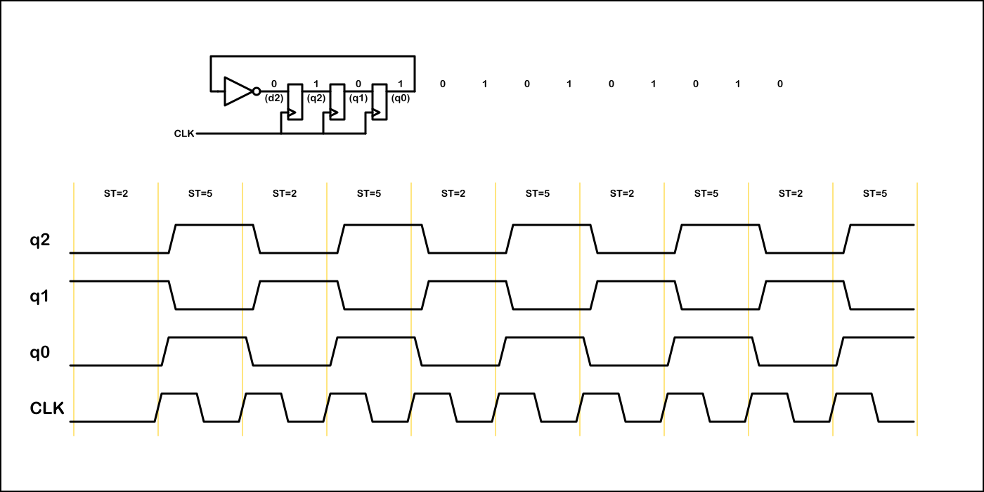
Simple State Machine – 3 Flip Flops (0 1 0) end

Slide 16
Number of Flip Flops / Number of States
N Flip Flops → 2^{N} Possible States
The next state is uniquely determined by the present state and feedback logic
As a counter cycles through its states it may :
  Cycle through all 2^{N} possible states
  Cycle through M states, where M < 2^{N}
  Have more than one stable mode of operation
  Have lock up states
The individual bits may have a single frequency or pseudo-random behavior

Slide 17
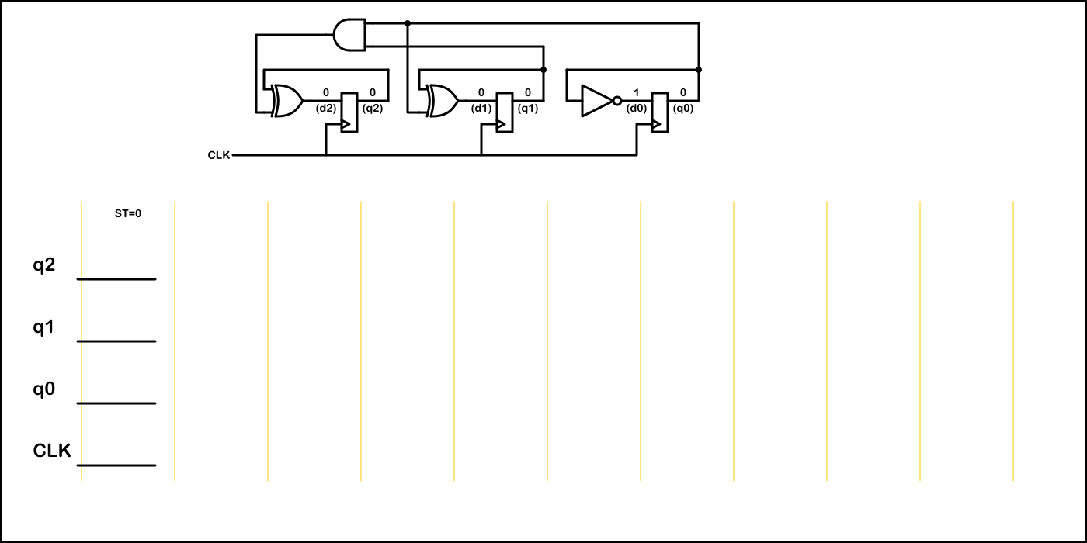
Binary Counter– 3 Flip Flops

Slide 18

Binary Counter– 3 Flip Flops (run)

Slide 19
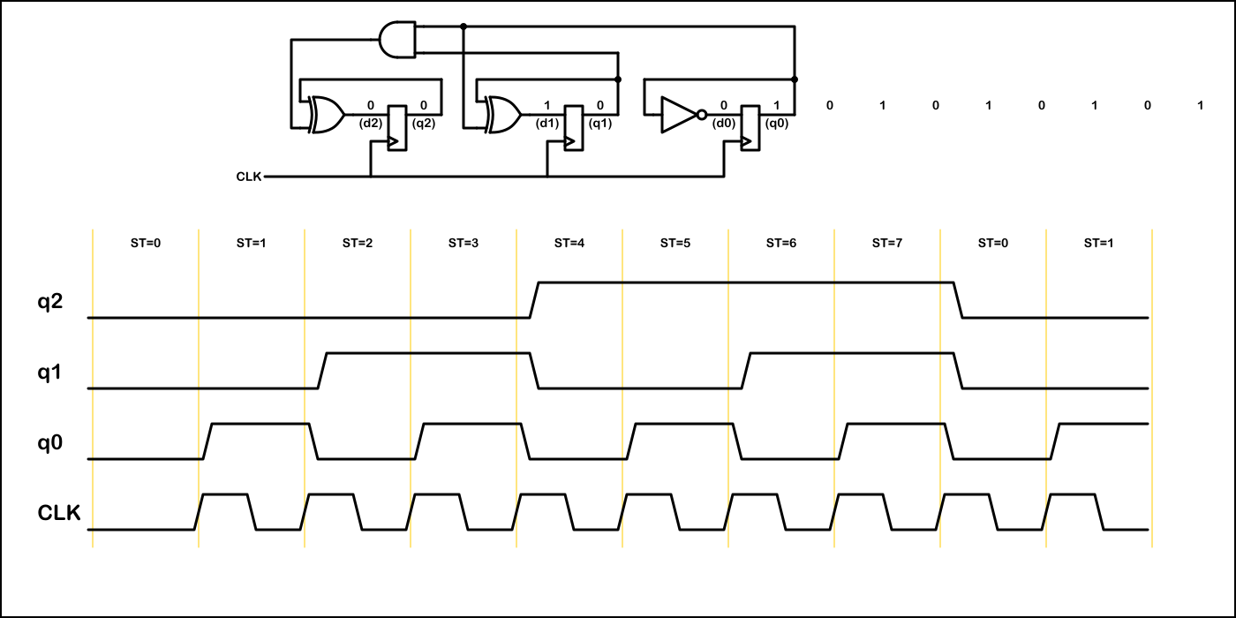
Binary Counter– 3 Flip Flops (end)

Slide 20
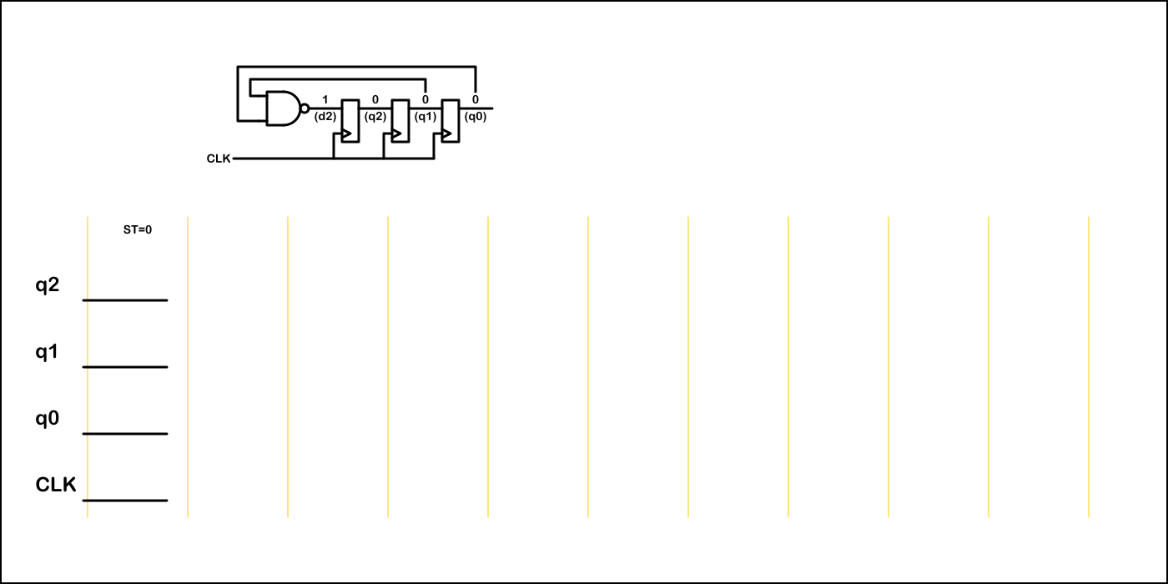
Div-by-5 : 3 Flip Flops

Slide 21

Div-by-5 : 3 Flip Flops (run)

Slide 22
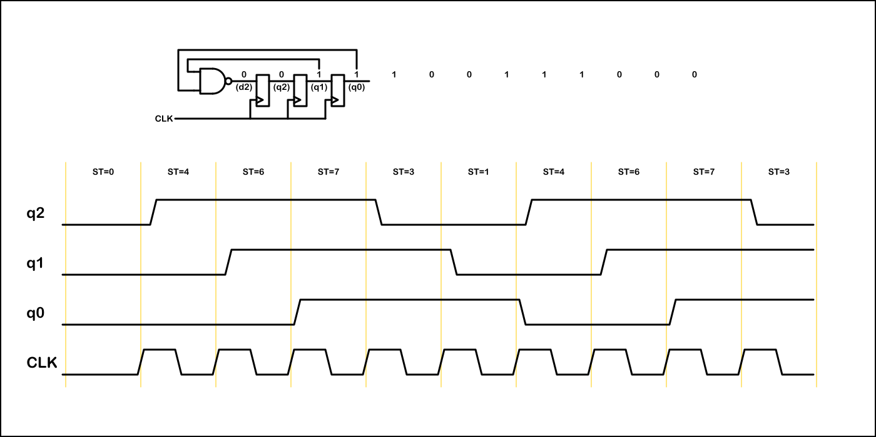
Div-by-5 : 3 Flip Flops (end)

Slide 23

Div-by-5 : 3 Flip Flops – (0 1 0)

Slide 24

Div-by-5 : 3 Flip Flops (run) – (0 1 0)

Slide 25
Div-by-5 : 3 Flip Flops (end) – (0 1 0)

Slide 26
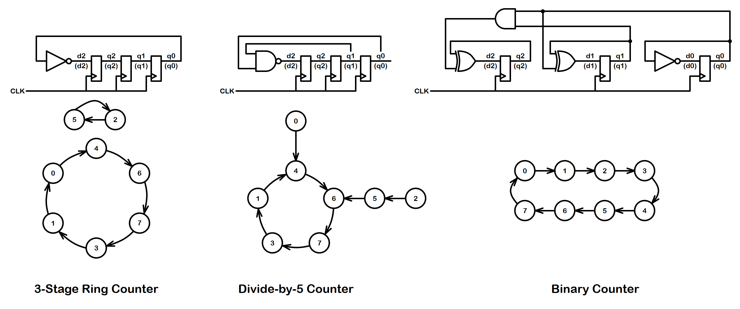
Counter Summary

Slide 27
Counter Summary – What Next?
All of these counters generate simple patterns.
Can we build a counter with a pseudo-random pattern?

Slide 28
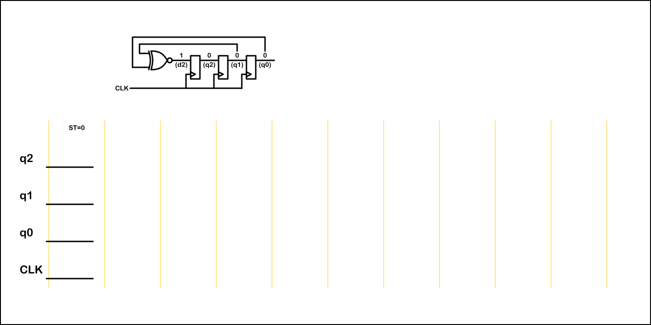
PRBS3 : 2³-1 Pseudo-Random Binary Seq.

Slide 29

PRBS3 : 2³-1 Pseudo-Random Binary Seq. (run)

Slide 30
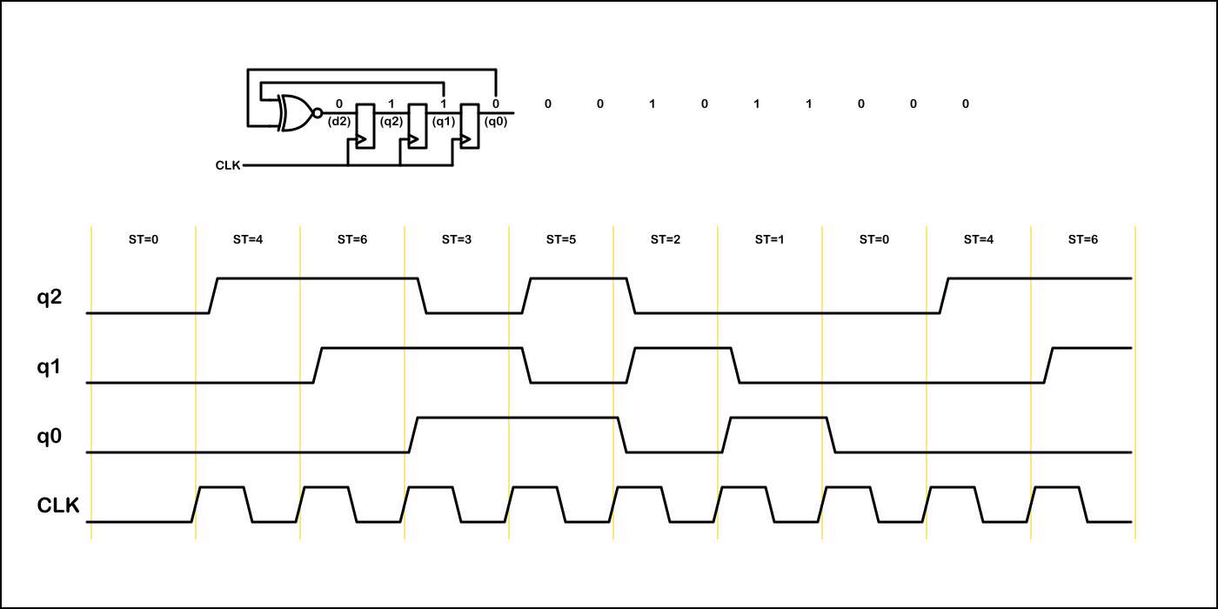
PRBS3 : 2³-1 Pseudo-Random Binary Seq. (end)

Slide 31
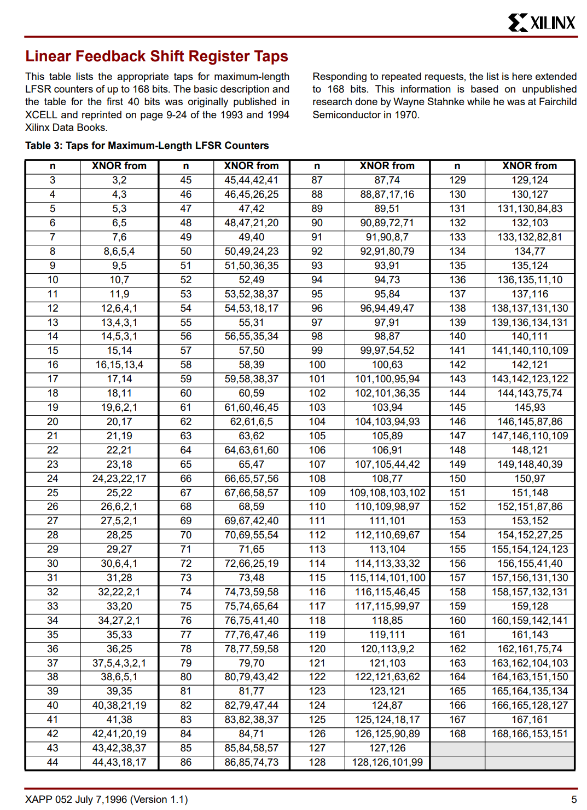
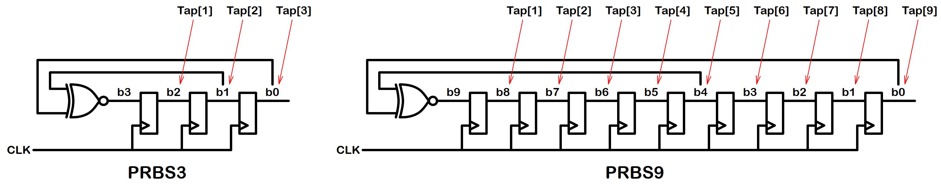
PRBS Sequences
Length of sequence is (2^{N}-1)
One lockup state
  With XNOR feedback all 1’s is the lockup state
  With XOR feedback all 0’s is the lockup state
Subsampling a PRBS results in the same PRBS sequence
Similar structures are used to generate and check PRBS patterns
Source - https://docs.amd.com/v/u/en-US/xapp052

Slide 32
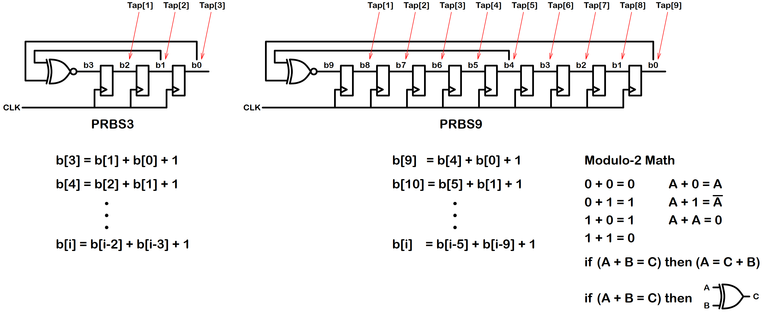
PRBS Sequences
In this labeling scheme b[0] is the first bit shifted out
New bits are created with the recurrence relations
  PRBS3 : b[i] = b[i-2] + b[i-3] + 1
  PRBS9 : b[i] = b[i-5] + b[i-9] + 1
Source - https://docs.amd.com/v/u/en-US/xapp052

Slide 33
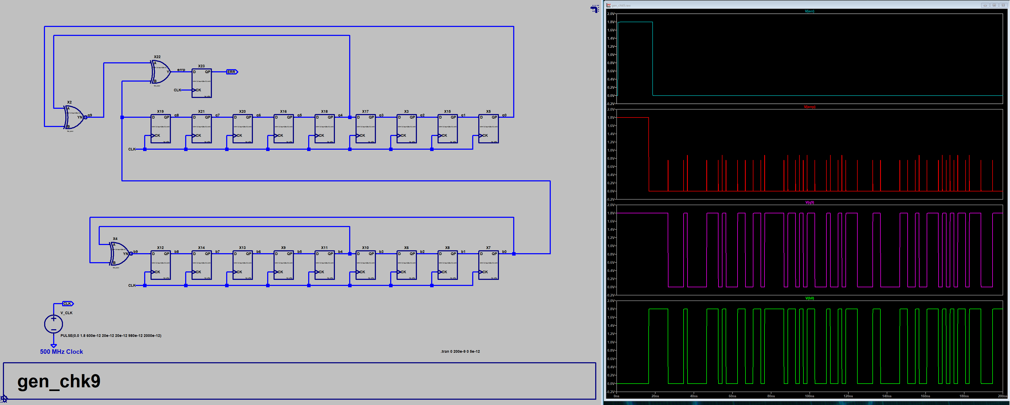
PRBS9 Generator / Checker
Feedback signal in checker is generated but not fed back!
Feedback signal is compared to incoming data
PRBS9 Checker
These two signals
should be equal
PRBS9 Generator

Slide 34
Parallel Generation and Checking
Generate more than one new bit each clock cycle
Example – Generate 20 bits per cycle of a PRBS31:
  Keep 32-bits of the PRBS sequence in memory
  Shift out 20-bits each clock cycle
  Calculate 20-new bits each clock cycle
(see diagrams on following pages)

Slide 35
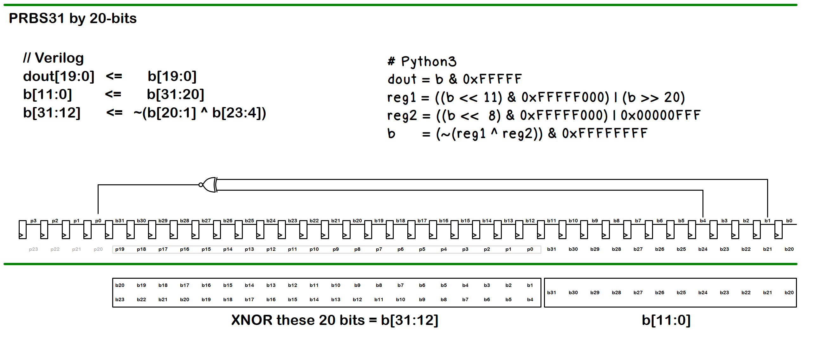
Parallel Generation and Checking

Slide 36
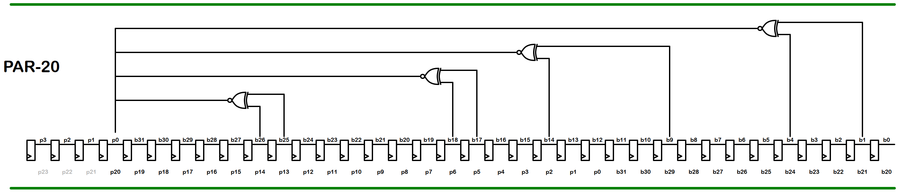
Parallel Generation and Checking
PRBS31
PRBS23
PRBS15
PRBS7
(RTL Code Available in 8B/10B example)

Slide 37
Dithering – Break Limit Cycles / Tones
A digital PRBS sequence allows a precise amount of “white” noise
It has a DC offset of 1 / (2^{N} -1)
It repeats with frequency clk/(2^{N} -1)

Slide 38
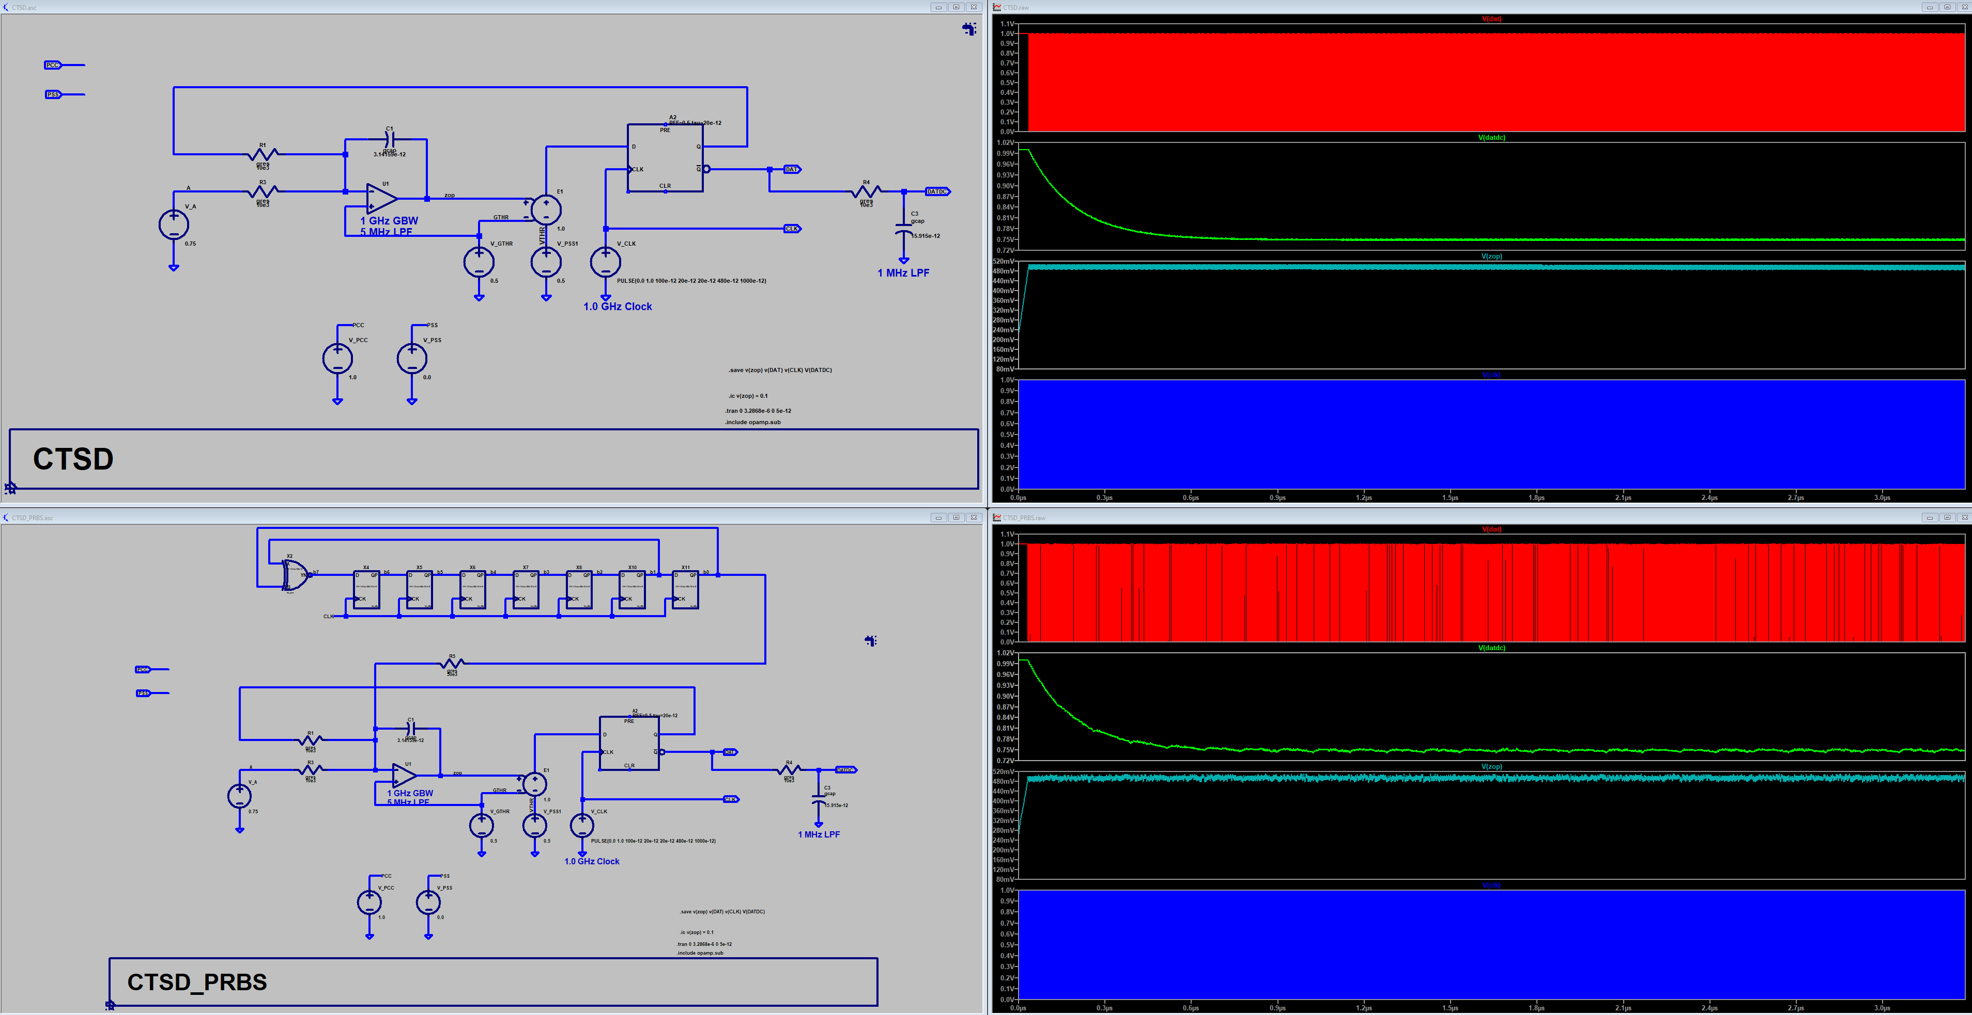
Dithering – LTSpice Continus Time ΣΔ

Slide 39
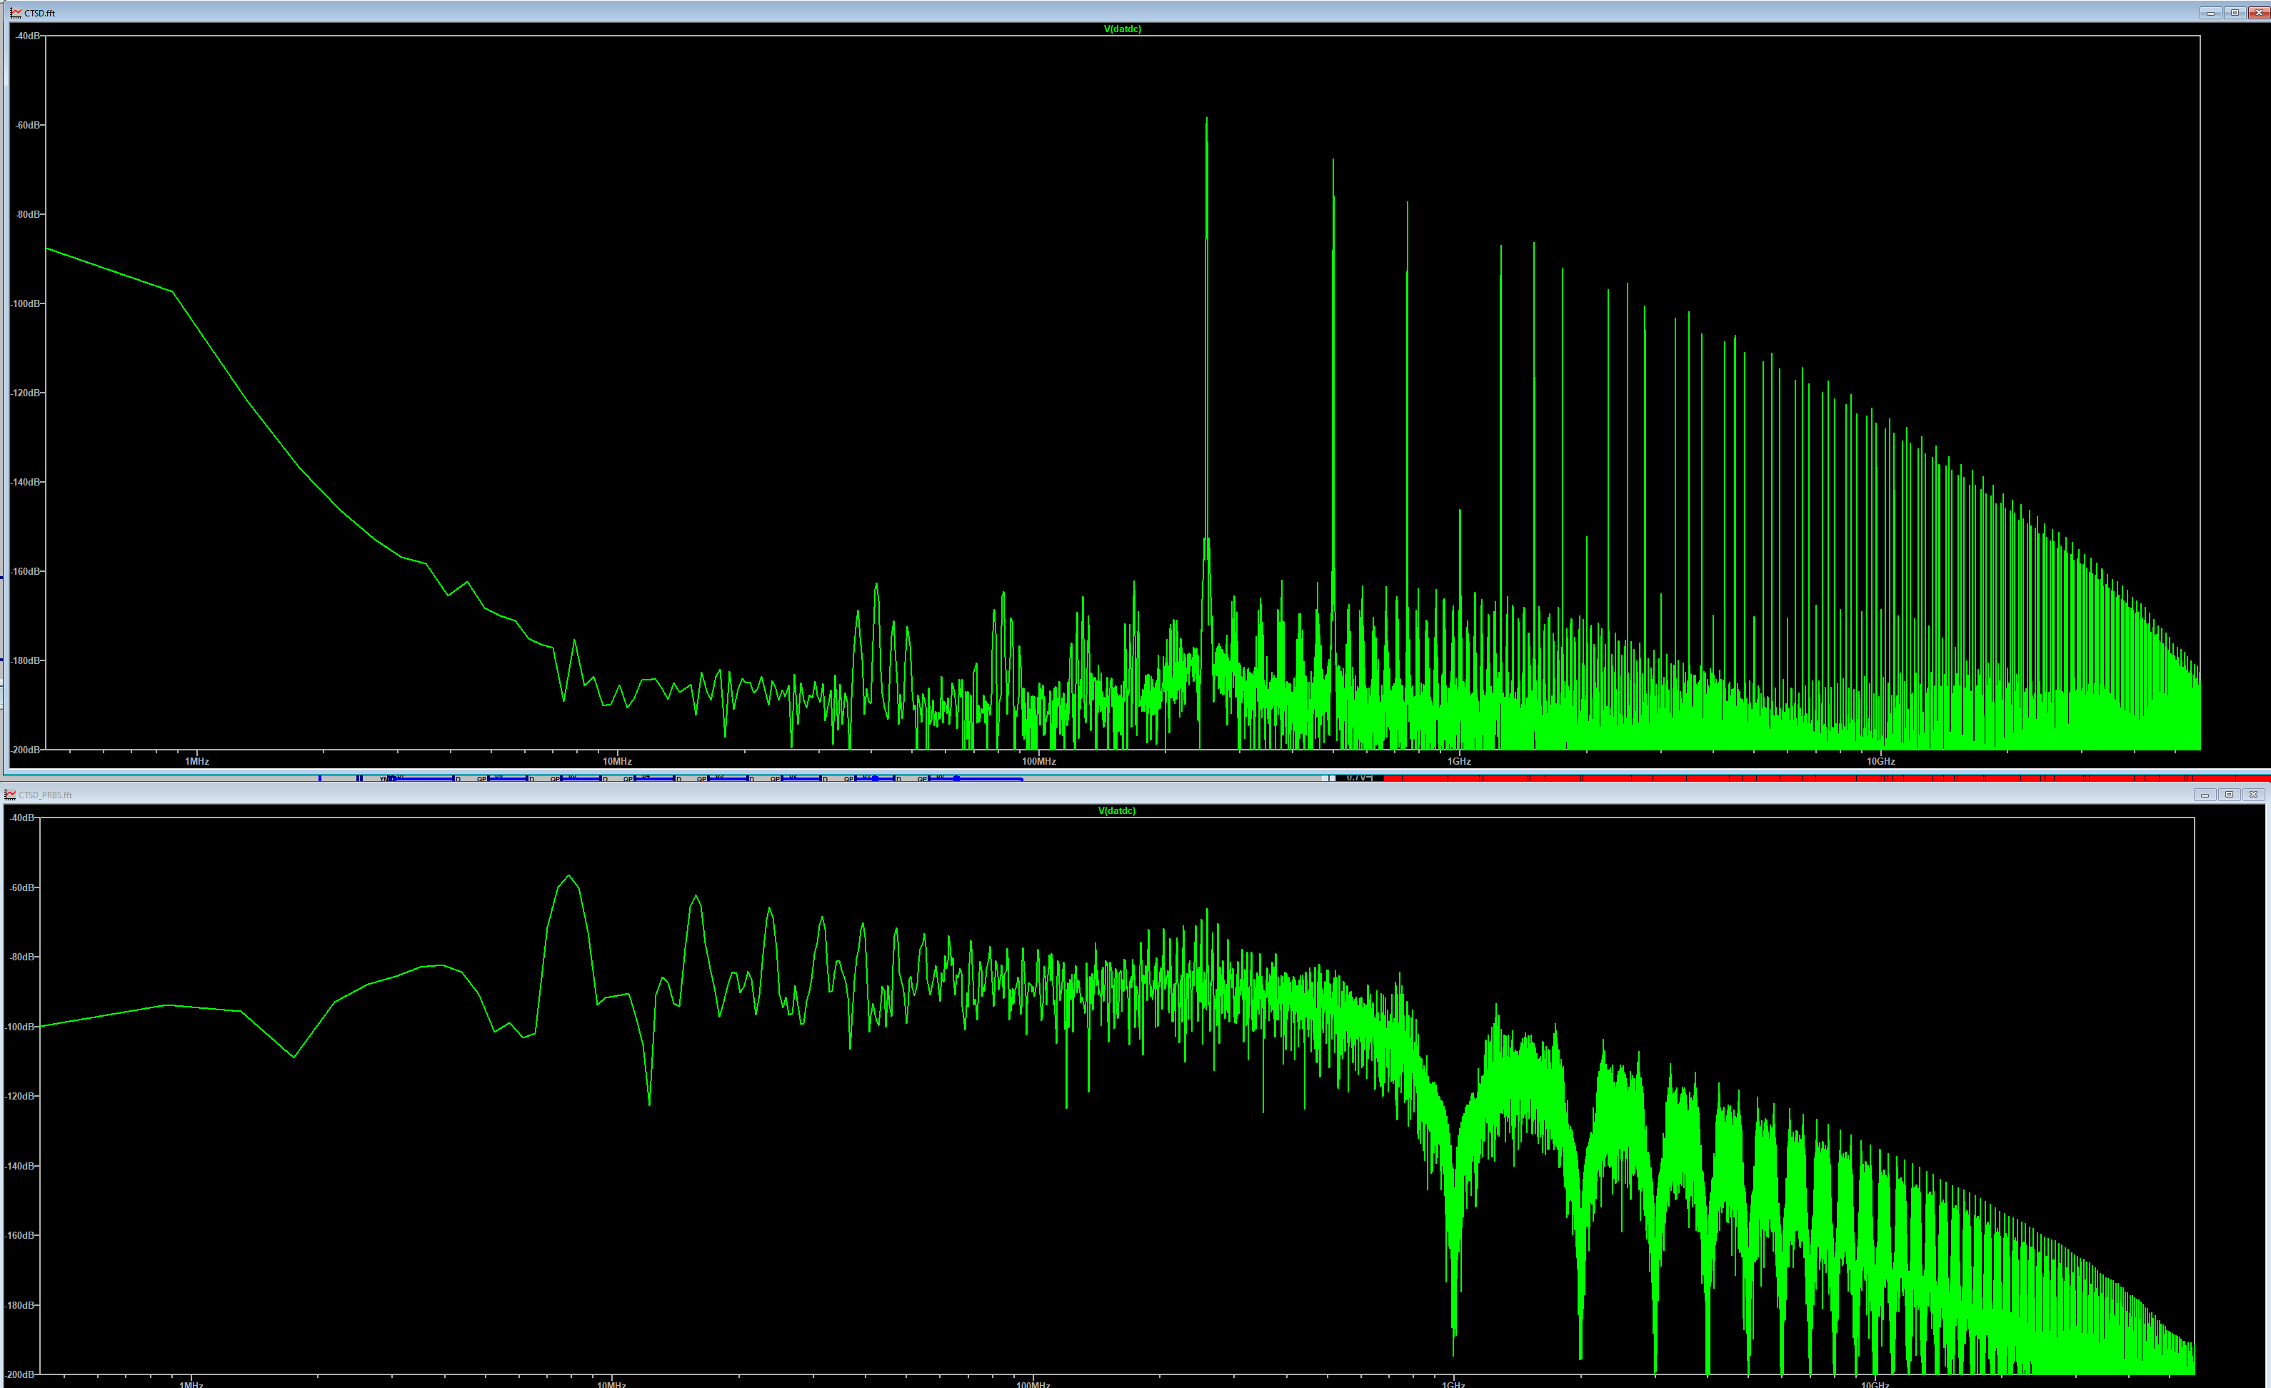
Dithering – LTSpice Continus Time ΣΔ

Slide 40
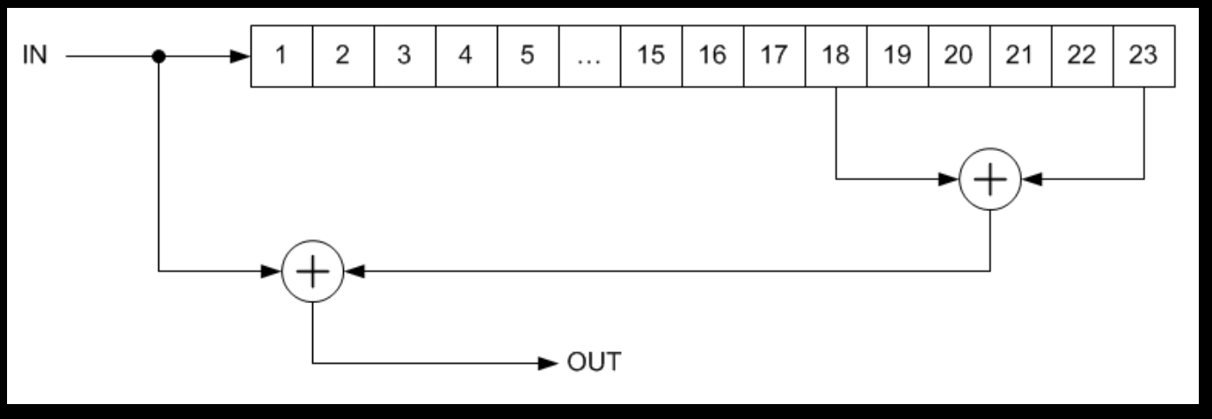
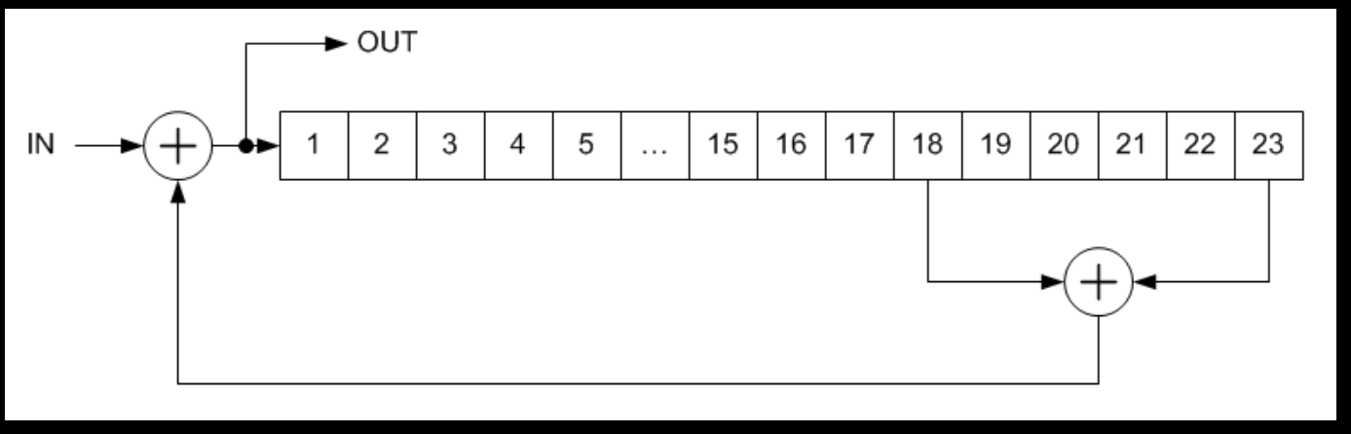
Scrambler / De-scrambler
Self Synchrnizing
It works much like a PRBS generator/checker.
The input is added to the sequence twice : Once in the scrambler and once in the de-scrambler.
Modulo-2 Math : A + B + B = A
https://en.wikipedia.org/wiki/Scrambler
De-scrambler
Scrambler

Slide 41
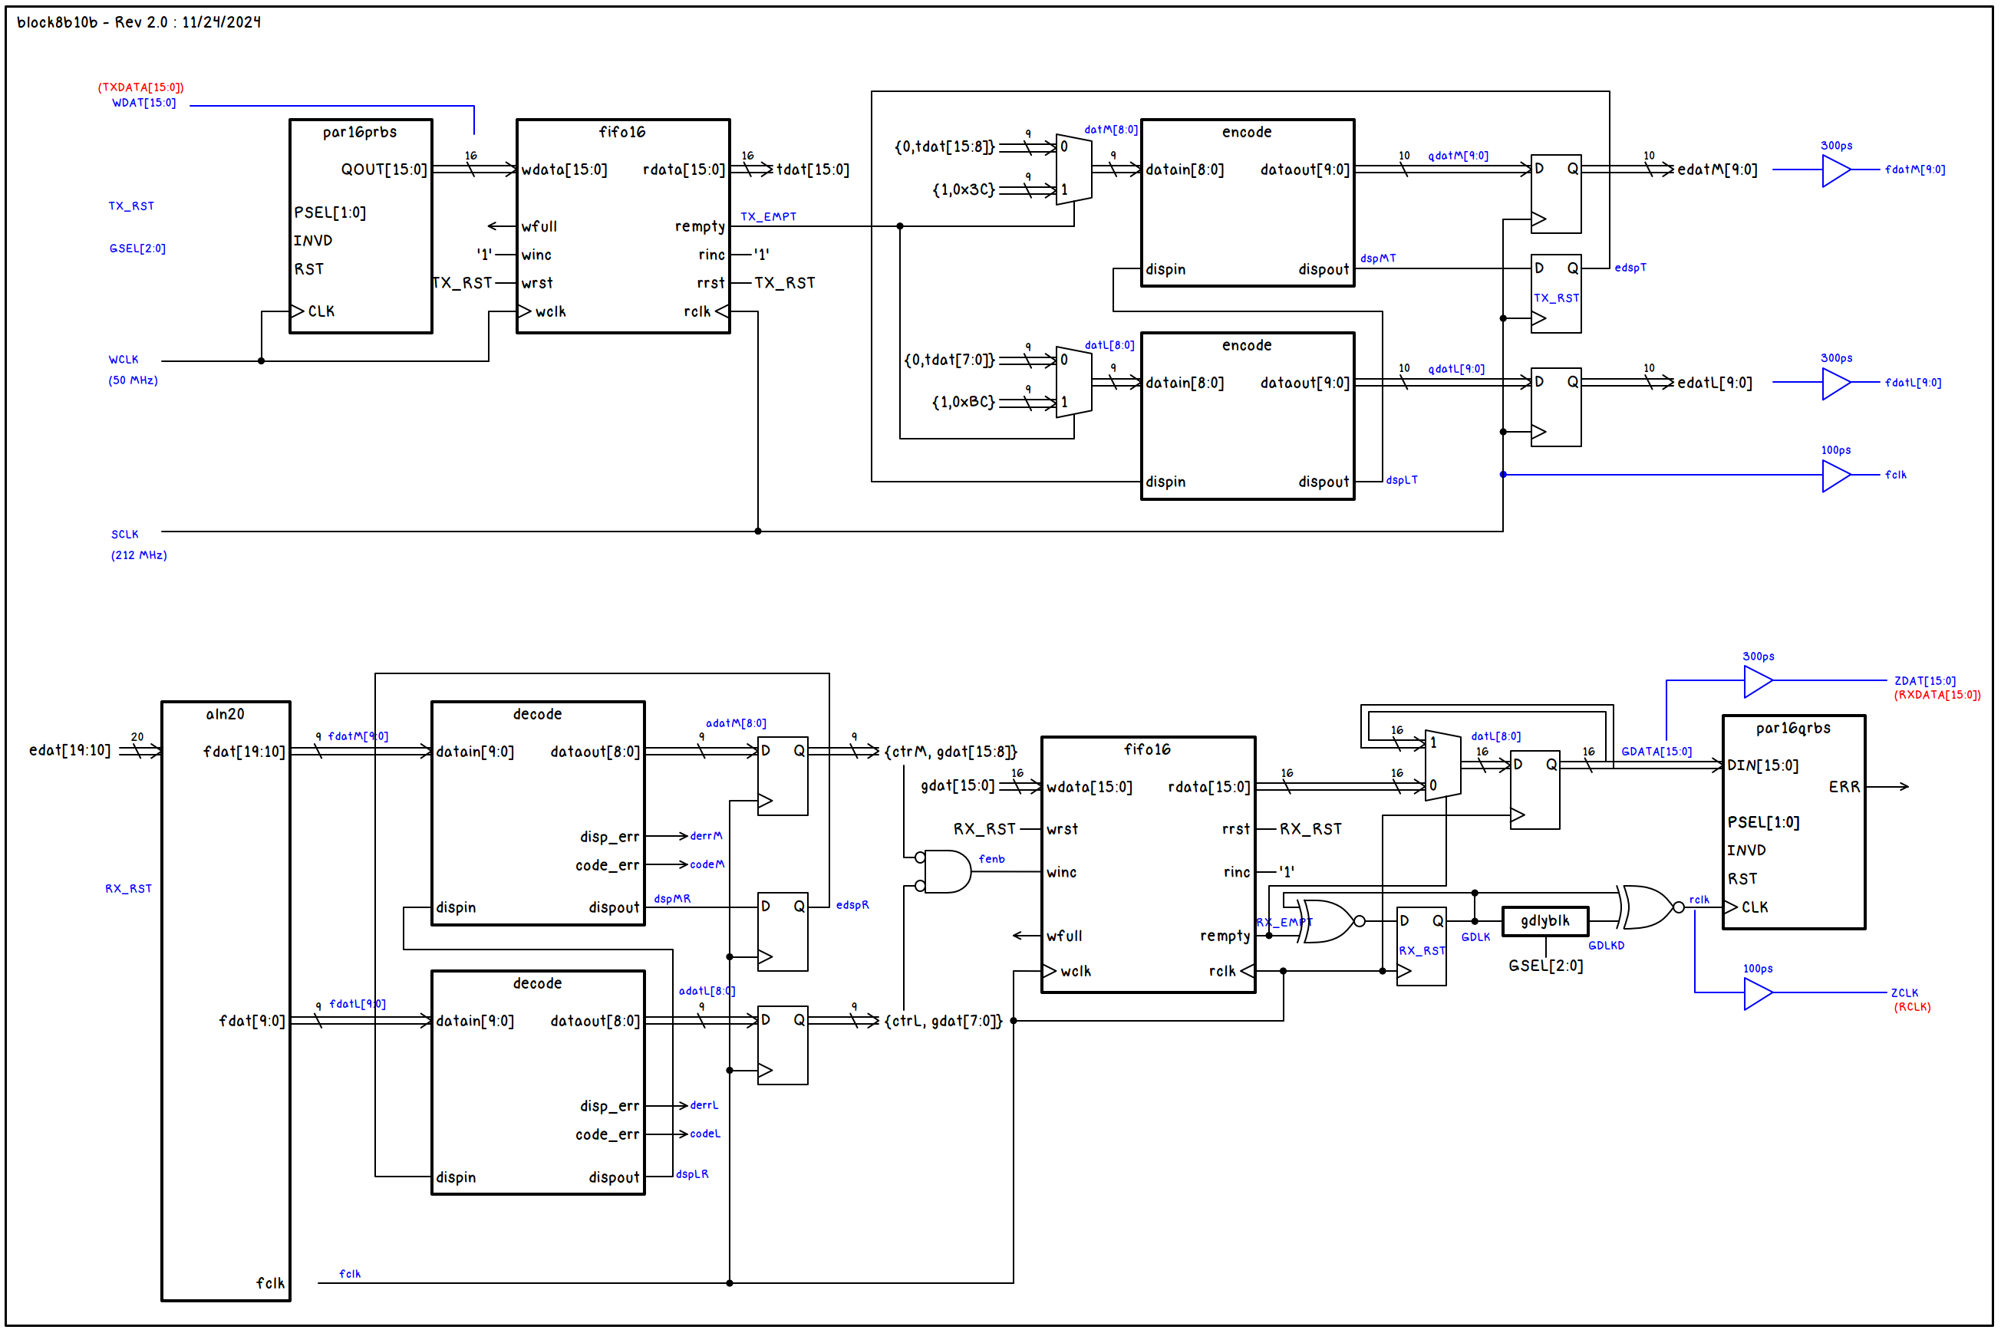
8B/10B Encoding/Decoding Verification
References and Sources :
// Cliff Cummings Fifo - CummingsSNUG2002SJ_FIFO1_rev1_2.doc
// http://www.sunburst-design.com/papers/CummingsSNUG2002SJ_FIFO1.pdf
// Chuck Benz, Hollis, NH Copyright (c)2002
// module encode (datain, dispin, dataout, dispout) ;
// module decode (datain, dispin, dataout, dispout, code_err, disp_err) ;

Slide 42
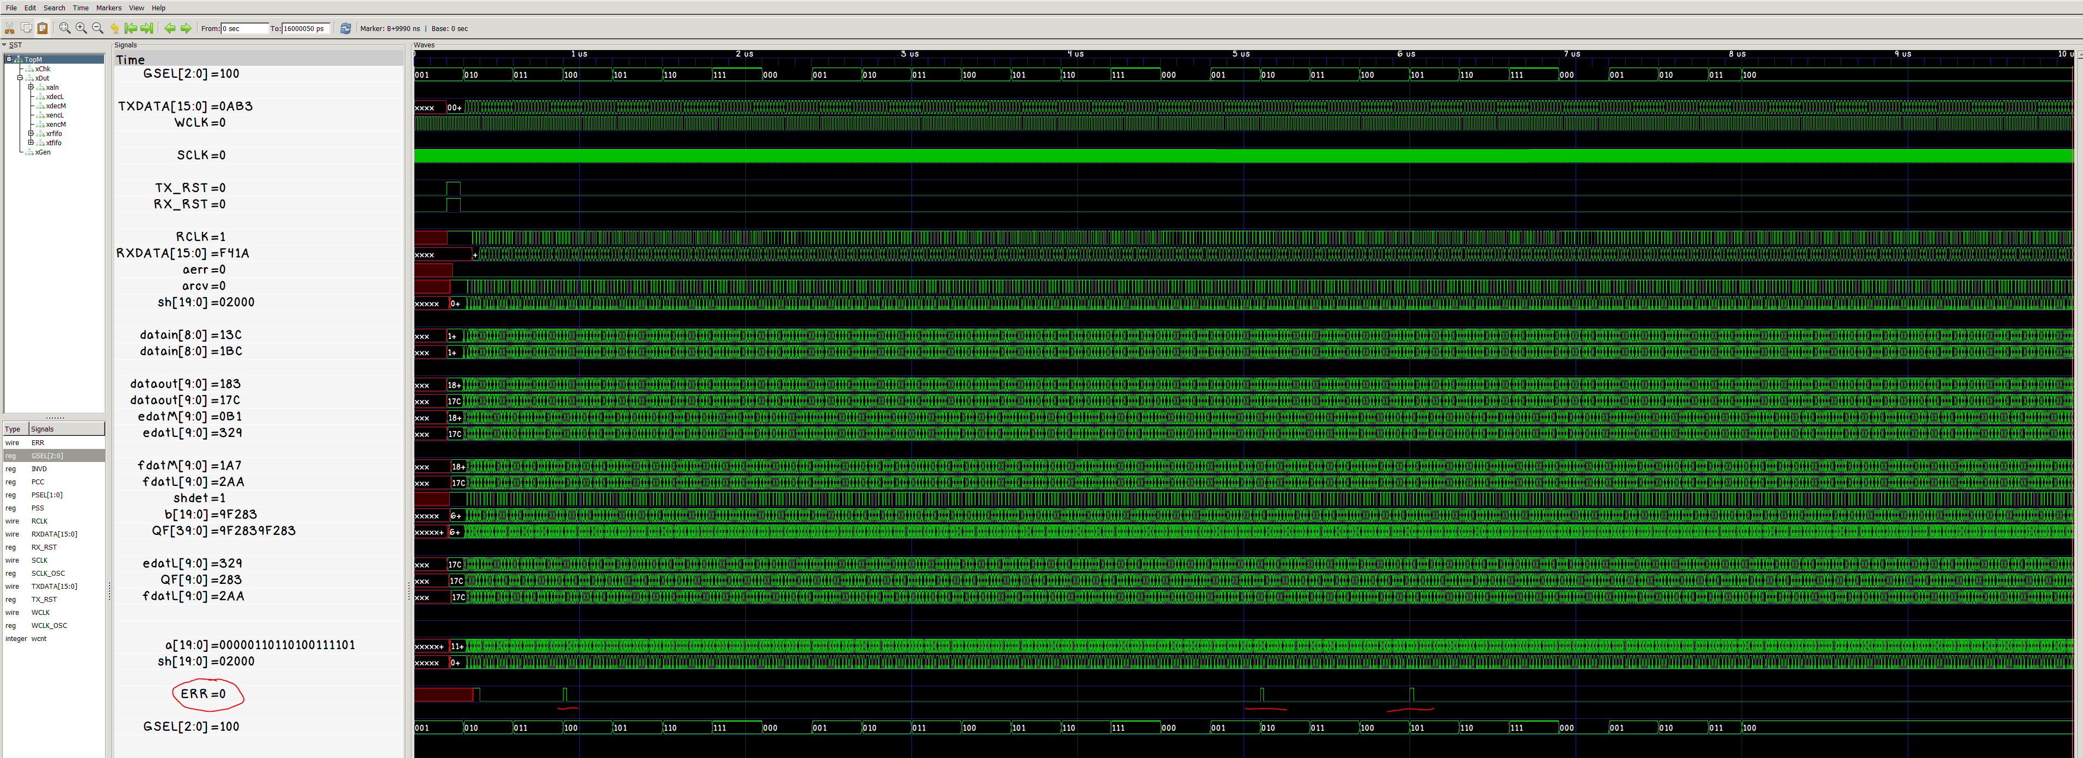
8B/10B Encoding/Decoding Verification

Slide 43
Thank you
Greg Warwar
gregwarwar@gmail.com
https://sfv-sscs.org/resources/prbs

